Slide 1

Databricks Asset Bundles Solution Design

Slide 2
Introduction
Currently the automated deployments are only for notebooks, where we copy all the notebooks and deploy them on the target environment by deleting the existing ones first and then copy the most recent version.
Databricks Asset Bundles make it possible to describe Databricks resources such as jobs, pipelines (Databricks Asset Bundles resources), and notebooks as source files. These source files provide an end-to-end definition of a project, including how it should be structured, tested, and deployed, which makes it easier to collaborate on projects during active development.
Bundles provide a way to include metadata alongside the project’s source files. This metadata is used to provision infrastructure and other resources. The project’s collection of source files and metadata is then deployed as a single bundle to your target environment.
For more information on Databricks Asset Bundles consult Databricks Documentation

Slide 3
Canopius Insights Environments
Current environment and sub environment structure
Development
Test
Production
Environment | Purpose
insights_dev_001 | Deployment testing Maintenance and init scripts Eventhub and DLTs related workflows, pipelines and notebooks
insights_dev_002 | General development
insights_dev_003 | General development
insights_dev_004 | Hotfixes development
Environment | Purpose
insights_test_001 | Deployment testing Maintenance and init scripts Eventhub and DLTs related workflows, pipelines and notebooks
insights_test_002 | Hotfixes deployment testing
Environment | Purpose
insights_prod | Production environment
For more info on the current environments consult Environments - Overview

Slide 4
CI/CD introduction
CI/CD is a series of steps that automate the process of software delivery, from code integration to deployment. CI/CD stands for Continuous Integration and Continuous Delivery/Deployment, which are practices aimed at improving software development and delivery through automation.
Continuous Integration (CI)
Continuous Integration involves developers frequently committing their code changes to a shared repository. Each user (developer) can commit their code to be under source control (users' deployment), but the code is only promoted to the master branch once is reviewed. A change on the master branch triggers an automated build and test process, ensuring that the new code integrates smoothly with the existing codebase (dev deployment). This practice helps in identifying and fixing bugs early, improving software quality, and reducing integration issues.
In our specific case we will introduce a concept of environment level (dev, test, prod) and sub environment level (dev_001, dev_002, dev_003, dev_004, test_001, test_002). The objective is to split everything that is related with maintenance, init scripts, eventhub and DLTs related workflows, pipelines and notebooks from the general notebooks, workflows and pipelines. Anything related with maintenance (etc) will be deployed on an environment level repository and all the rest will be deployed on a sub environment level repository.

Slide 5
CI/CD introduction
Continuous Delivery extends CI by automating the release process. After the code passes the CI pipeline, it is deployed to a test environment where further tests, such as integration and regression tests, are conducted. This ensures that the code is always in a deployable state.
On Insights this step is achieved through a pull request from development to test.
Continuous Deployment takes CD a step further by automating the deployment to production. Every change that passes the automated tests is automatically deployed to the production environment, after the necessary approvals.
In this case:
  The maintenance (etc) related objects will move from the environments dev to test to prod.
  All the remaining objects will move from the sub environments (dev_001, dev_002, dev_003, dev_004) to (test_001, test_002) to prod.

Slide 6

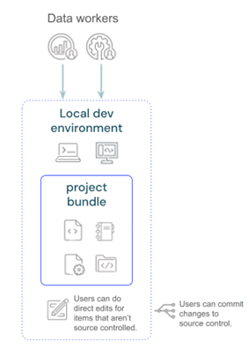

Solution design
Databricks workspaces
Development
Test
Production
dev
dev_001
dev_002
dev_003
dev_004
users
workspaces
test
test_001
test_002
prod
users deployment
dev deployment
test deployment
production deployment
Users can
manually
deploy to see
and test
changes in
dev.
Code is deploed to dev main branch once approved.
Code is deployed to test after being tested and approved.
Code is deployed to production after
review and approval.
Code is deployed to dev
main branch once
approved.
Users can do direct edits for items that aren't source controlled.
Users can commit changes to source control.
Notifications
trigger CI/CD
Configure service principals,
kick off runs of jobs, and
other tasks.

Slide 7
Solution design – Asset Bundles
Environments |  | Notebooks |  | Workflows |  | Pipelines |  | Asset Bundles
 |  | Notebooks for DLTs and init scripts | All other Notebooks | Eventhub related and maintenance | All other Workflows | Eventhub related | All other Pipelines
Development | dev | ✓ |  | ✓ |  | ✓ |  | ABundleEnvironment
 | dev_001 |  | ✓ |  | ✓ |  | ✓ | ABundleSubEnvironment
 | dev_002 |  | ✓ |  | ✓ |  | ✓ | ABundleSubEnvironment
 | dev_003 |  | ✓ |  | ✓ |  | ✓ | ABundleSubEnvironment
 | dev_004 |  | ✓ |  | ✓ |  | ✓ | ABundleSubEnvironment
Test | test | ✓ |  | ✓ |  | ✓ |  | ABundleEnvironment
 | test_001 |  | ✓ |  | ✓ |  | ✓ | ABundleSubEnvironment
 | test_002 |  | ✓ |  | ✓ |  | ✓ | ABundleSubEnvironment
Prod | prod | ✓ | ✓ | ✓ | ✓ | ✓ | ✓ | ABundleEnvironment and ABundleSubEnvironment

Slide 8
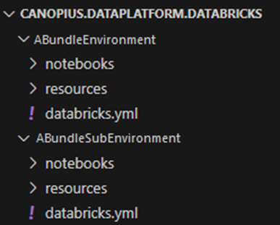
Solution design – Asset Bundles
1 folder for each of the asset bundles with the respective configuration file (databricks.yml)
1 sub-folder with the resources configuration (1 .yml file for each job and/or pipeline)
1 sub-folder with the notebooks
ABundleEnvironment will contain all the artifacts (notebooks, jobs and pipelines) for DLTs, maintenance, init and EventHub related
ABundleSubEnvironment will contain all the remaining artifacts

Slide 9
Solution design - Devops
Create an extra repository for notebooks, jobs and pipelines related with DLTs, maintenance, init and EventHub. This repository will be the environment level as explained before. The existing repositories will be used as sub environment levels.
In terms of devops pipelines the structure will be the following:
  2 pipelines for development (1 for dev (ABundleEnvironment) and another for dev_001, dev_002, dev_003 and dev_004 (ABundleSubEnvironment))
  2 pipelines for test and production (1 for test and prod (ABundleEnvironment) and another for test_001, test_002 and prod (ABundleSubEnvironment))
The pipelines will be similar to the already existing ones, creating an artifact with a copy of the asset bundle folder which will only contain the relevant objects for the environment or sub environment.
The releases will also be similar to the existing ones, deploying in the correct environments or sub environments by validating and deploying the asset bundle in the artifact created in the pipelines.
Developers will not need to get out the entire branch in databricks, they would do a sparse checkout for the notebooks folder down.

